Slide 1
Paging II
Steps:
Go to slide 2
Select slide show option
Click on Replay
OR
Click on speaker at the bottom right corner of the slide

Slide 2

Implementation of Page Table
Page table is kept in main memory
Page-table base register (PTBR) points to the page table
Page-table length register (PTLR) indicates size of the page table
In this scheme every data/instruction access requires two memory accesses
One for the page table and one for the data / instruction
The two memory access problem can be solved by the use of a special fast-lookup hardware cache called associative memory or translation look-aside buffers (TLBs)

Slide 3
Implementation of Page Table (Cont.)
Some TLBs store address-space identifiers (ASIDs) in each TLB entry – uniquely identifies each process to provide address-space protection for that process
Ensures that ASID of currently running process matches with the virtual page numbers.
TLBs typically small (64 to 1,024 entries)
On a TLB miss, value is loaded into the TLB for faster access next time
Replacement policies must be considered
Some entries are wired down (they can’t be removed from TLB ie.kernel code )

Slide 4
Associative Memory
Associative memory – parallel search
Address translation (p, d)
If p is in associative register, get frame # out
Otherwise get frame # from page table in memory

Slide 5

Paging Hardware With TLB

Slide 6
Effective Access Time
[Hit ratio – percentage of time that a page number is found in the associative registers]
TLB hit 80%, 20ns for TLB search, 100ns for memory access, then
a mapped-memory access takes 120 nanoseconds when the page
number is in the TLB.
If we fail to find the page number in the TLB (20 nanoseconds),then we must first access memory for the page table and frame number (100 nanoseconds) and then access the desired byte in memory (100 nanoseconds),for a total of 220 nanoseconds
Effective Access Time (EAT)
EAT = 0.80 x [ TLB access Time + memory access time] +
0.20 x [TLB access Time + Page table access time + memory access time]
= 0.80 x 120 + 0.20 x 220 = 140ns
For 98% hit ratio
EAT = 0.98 x 120 + 0.02 x 220 = 122ns

Slide 7
Memory Protection
Memory protection implemented by associating protection bit with each frame to indicate if read-only or read-write access is allowed
Can also add more bits to indicate page execute-only, and so on
Valid-invalid bit attached to each entry in the page table:
“valid” indicates that the associated page is in the process’ logical address space, and is thus a legal page
“invalid” indicates that the page is not in the process’ logical address space
Or use page-table length register (PTLR)
Any violations result in a trap to the kernel

Slide 8

Memory Protection: Valid (v) or Invalid (i) Bit In A Page Table

Slide 9
Shared Pages
Shared code
Reentrant code is non-self-modifying code: it never changes during execution. Thus, two or more processes can execute the same code at the same time.
One copy of read-only (reentrant) code shared among processes (i.e., text editors, compilers etc)
Similar to multiple threads sharing the same process space
Private code and data
Each process keeps a separate copy of the code and data
The pages for the private code and data can appear anywhere in the logical address space

Slide 10
If the text editor consists of 150 KB of code and 50 KB of data space, we need 8,000 KB(150*40+50*40) to support the 40 users.
To support 40 users, we need only one copy of the editor (150 KB), plus 40 copies of the 50 KB of data space per user.
The total space required is now 2150 KB(150+50*40) instead of 8,000 KB

Slide 11
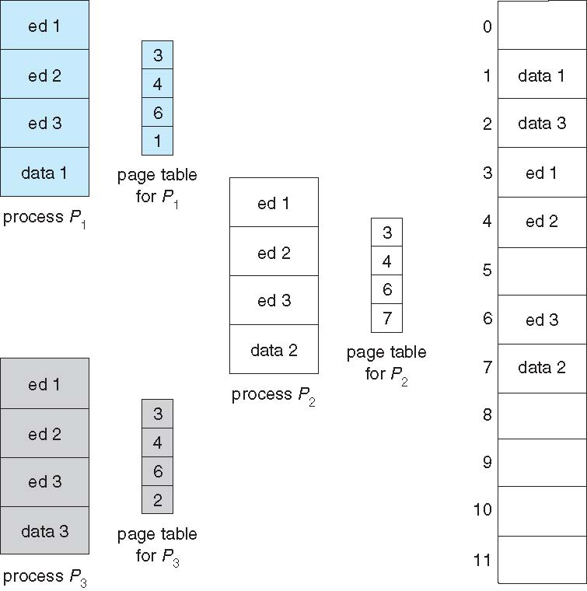
Shared Pages Example

Slide 12
Structure of the Page Table
Memory structures for paging can get huge using straight-forward methods
Consider a 32-bit logical address space as on modern computers
Page size of 4 KB (2¹²)
Page table would have 1 million entries (2³² / 2¹²)
If each entry is 4 bytes -> 4 MB of physical address space / memory for page table alone
That amount of memory used to cost a lot
Don’t want to allocate that contiguously in main memory
Hierarchical Paging

Slide 13
Hierarchical Page Tables
Break up the logical address space into multiple page tables
A simple technique is a two-level page table
We then page the page table

Slide 14

Two-Level Page-Table Scheme

Slide 15
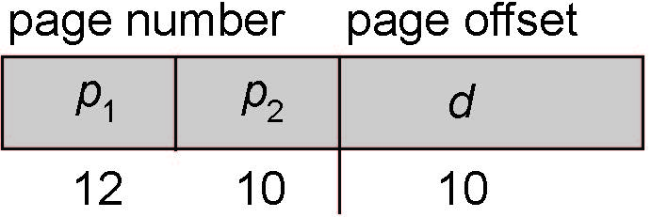
Two-Level Paging Example
A logical address (on 32-bit machine with 1K page size) is divided into:
a page number consisting of 22 bits
a page offset consisting of 10 bits
Since the page table is paged, the page number is further divided into:
a 12-bit page number
a 10-bit page offset
Thus, a logical address is as follows:
where p₁ is an index into the outer page table, and p₂ is the displacement within the page of the inner page table
Known as forward-mapped page table

Slide 16

Address-Translation Scheme

Slide 17
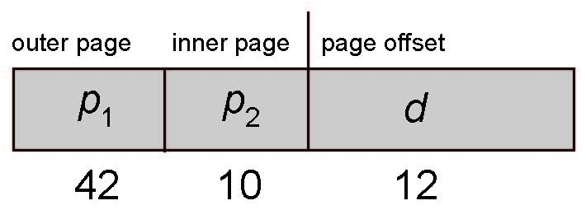
64-bit Logical Address Space
Even two-level paging scheme not sufficient
If page size is 4 KB (2¹²)
Then page table has 2⁵² entries
If two level scheme, inner page tables could be 2¹⁰ 4-byte entries
Address would look like
Outer page table has 2⁴² entries or 2⁴⁴ bytes
One solution is to add a 2nd outer page table
But in the following example the 2nd outer page table is still 2³⁴ bytes in size
And possibly 4 memory access to get to one physical memory location

Slide 18


Three-level Paging Scheme

Slide 19
Hashed Page Tables
Common in address spaces > 32 bits
The virtual page number is hashed into a page table
This page table contains a chain of elements hashing to the same location
Each element contains (1) the virtual page number (2) the value of the mapped page frame (3) a pointer to the next element
Virtual page numbers are compared in this chain searching for a match
If a match is found, the corresponding physical frame is extracted
Variation for 64-bit addresses is clustered page tables
Similar to hashed but each entry refers to several pages (such as 16) rather than 1
Especially useful for sparse address spaces (where memory references are non-contiguous and scattered)

Slide 20

Hashed Page Table

Slide 21
Inverted Page Table
Rather than each process having a page table and keeping track of all possible logical pages, track all physical pages
One entry for each real page of memory
Entry consists of the virtual address of the page stored in that real memory location, with information about the process that owns that page
Decreases memory needed to store each page table, but increases time needed to search the table when a page reference occurs
Use hash table to limit the search to one — or at most a few — page-table entries
TLB can accelerate access
But how to implement shared memory?
One mapping of a virtual address to the shared physical address

Slide 22

Inverted Page Table Architecture

